Slide 1
Exploring nutritional status determinants among adult men in Bangladesh: A multinomial logistic regression approach
8th International Conference on The Role of Statistics and Data Science in 4IR
organized by the Department of Statistics, University of Rajshahi

Slide 2


Our Team
Shuvongkar Sarkar ¹
Md. Ismail Hossain¹
Dr. Muhammad Tareq ²
Tahsina Fariha Ohi²
Shabnam Bashir²
¹ Department of Mathematics and Natural Sciences, BRAC University,
Dhaka, Bangladesh.
²Department of Statistics, Jagannath University, Dhaka, Bangladesh.

Slide 3
Outline
♦Background
♦Objectives
♦Methodology
♦Results
♦Strengths &
Limitations
♦Conclusion

Slide 4
♦ Background

Slide 5
♦ Background
Both undernutrition and overnutrition are among the top 10 leading risk factors for the global burden of diseases (Murray et al., 2019).
Improved nutrition is associated with longer lifespan, healthy life, bolstered immune systems, and reduced susceptibility to diabetes, cardiovascular and other non-communicable disease (WHO, 2022).
Both men and women have distinct nutrient requirements, although their overall nutritional needs are generally similar (Vaezghasemi et al., 2014).

Slide 6
♦ Background (cont.)
Numerous studies worldwide, including in Bangladesh, predominantly focus on the nutritional status of women, children, and adolescents.
There has been a noticeable gap in the exploration of nutritional aspects specific to adult men.
Moreover, most studies related to nutrition group undernutrition and normal, or overnutrition and normal, together, which fails to reflect the true scenario.

Slide 7
♦ Objectives

Slide 8
♦ Objectives
General objective
Investigate the prevalence of nutritional status among adult men in Bangladesh by exploring nutritional determinants.
Specific objectives
Identify covariates associated with nutritional status.
Examine the impact of various covariates on nutritional status.

Slide 9
♦ Methods

Slide 10

♦ Methodology
Data: Used secondary data from nationally representative the Bangladesh Demographic and Health Survey (BDHS), 2017-18.
Sample Size: 5533 men whose body mass index was measured were included in this study.
Dependent variable : “Nutrition Status”, which was classified into three categories as follows,
Nutrition Status=$\left\{\begin{matrix}Under nutrition, If BMI<18.5 kg/m^{2} \\ \begin{aligned} \\ Normal , If 18.50 kg/m^{2}≤BMI≤24.90 kg/m^{2} \\ \end{aligned} \\ Over nurition, If BMI>24.90 kg/m^{2} \end{matrix}\right.$

Slide 11
♦ Methods (cont.)
Independent variables: This study included various selected socio-demographic and economic variables as independent variable such as:
Region
Place of residence
Respondent age
Wealth status
Educational level
Smoking habit
Caffeinated drinking habit
Marital Status
Currently working status
Diabetes
Hypertension.

Slide 12

♦ Methods (cont.)
Chi-square test was used to examine the association between nutrition status and each covariate.
Multinomial baseline logistic regression was used to examine the impact of various covariates on nutritional status. It can be defined as,
$$\log\left[\frac{P\left(Y=j | X\right)}{P\left(Y=J | X\right)}\right]=α_{j}+{β^{′}}_{j}X, j=1,2, …,J−1$$
J presents the baseline category, which pairs with the other j categories. For this data, the baseline category is the Normal category, which pairs with under nutrition and over nutrition categories.

Slide 13
♦ Results

Slide 14
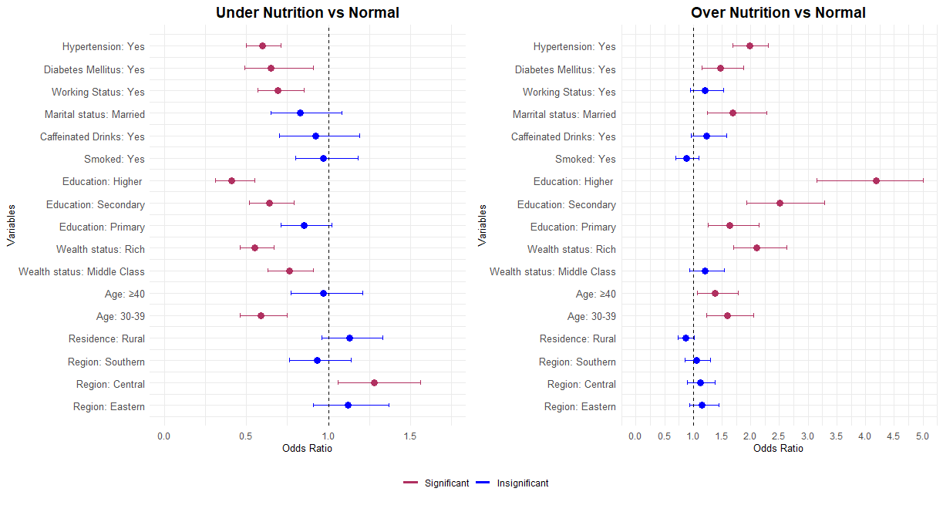
Results

Slide 15
Results

Slide 16
Results

Slide 17
♦ Strengths & Limitations

Slide 18
♦ Strengths
Utilized a national representative survey data which is the key strength of this study.
Did not force group undernutrition and normal or overnutrition and normal in one group.

Slide 19
♦ Limitations
Due to data constraints, the study couldn’t incorporate several significant factors pivotal in determining malnutrition.
Since cross-sectional design, establishing causal-effect relationships was not feasible.

Slide 20
♦ Conclusion

Slide 21
♦ Conclusion
The need for targeted interventions, considering both regional and socioeconomic contexts, to uplift overall nutritional status.
Emphasizes the importance of tailored strategies to address the specific challenges faced by individuals in different regions and socio-economic strata.

Slide 22
♦ References
Murray, C. J., Aravkin, A. Y., Zheng, P., Abbafati, C., Abbas, K. M., Abbasi-Kangevari, M., ... & Borzouei, S. (2020). Global burden of 87 risk factors in 204 countries and territories, 1990–2019: a systematic analysis for the Global Burden of Disease Study 2019. The lancet, 396(10258), 1223-1249.
World Health Organization. (2022). Nutrition. Retrieved from https://www.who.int/health-topics/nutrition#tab=tab_1.
Vaezghasemi M, Öhman A, Eriksson M et al. The Effect of Gender and Social Capital on the Dual Burden of Malnutrition: a Multilevel Study in Indonesia. PLOS ONE 2014; 9: (8)e103849.

Slide 23
♦ Thanks!
Do you have any questions?
ext.shuvongkar@bracu.ac.bd

